Slide 1
Kinematics
Content
3.1 Linear motion
3.2 Non-linear motion

Slide 2
Introduction to Kinematics
Definition:
Kinematics is the branch of mechanics which deal with the motion of bodies without references to the force which act of the system.
Two types of motions
Linear motion
Projectile motion (Nonlinear)

Slide 3
Distance & displacement
DISTANCE | DISPLACEMENT
Total length covered irrespective of the direction of motion. | Linear distance from a given reference point in a specific direction.
Only magnitude is specified. | Magnitude and direction are specified.
Hence it is a scalar quantity. | Hence it is a vector quantity.
(S.I unit: m)

Slide 4
Distance & displacement
Example:
A person is walking 80m to the East (+ve x-axis) and then turn around and
walking back West (-ve x-axis) a distance of 40m. What is the total distance
traveled and its displacement? Assuming the reference point is at (0,0).
Answer:
Total distance traveled: 120m
Displacement: 40m to the East
y
80 m
x
(East)
0
40 m
40 m
displacement

Slide 5
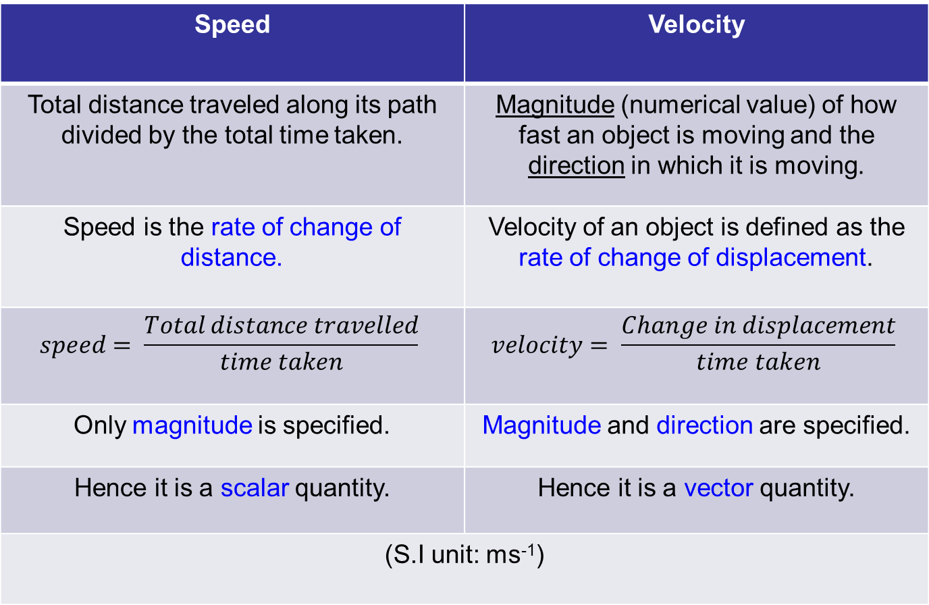
Speed & Velocity
Speed | Velocity
Total distance traveled along its path divided by the total time taken. | Magnitude (numerical value) of how fast an object is moving and the direction in which it is moving.
Speed is the rate of change of distance. | Velocity of an object is defined as the rate of change of displacement.
Only magnitude is specified. | Magnitude and direction are specified.
Hence it is a scalar quantity. | Hence it is a vector quantity.
(S.I unit: ms⁻¹)

Slide 6
SPEED VS VELOCITY
Example:
A person is walking 80m to the East (+ve x-axis) and then turn around and
walking back West (-ve x-axis) a distance of 40m. Suppose this walk took 60
seconds to complete.
What is the speed and velocity ?
Answer:
speed: 2m/s
velocity: 0.67m/s
y
80 m
x
(East)
0
40 m
40 m
displacement

Slide 7
ACCELERATION
An object whose velocity in changing is said to be accelerating.
It is a vector quantity.
S.I unit: m/s²
Acceleration is defined as the rate of change of velocity.
A change in velocity can be caused by:
i.) A change in magnitude only
ii.) A change in magnitude and direction simultaneously
iii.) A change in direction only. E.g: circular motion
Change of velocity
Final velocity, v – initial velocity, u
Acceleration =
=
Time taken
Time taken , t

Slide 8
ACCELERATION
Example:
A car accelerates along a straight road from rest to 75 km/h in 5.0s.
What is the magnitude of its acceleration ? (in m/s²)
Answer: 4.2 m/s²

Slide 9
Determination of Sign Convention
Since displacement, velocity and acceleration are all vector quantities, thus the direction of motion is important.
When we attempt to calculate the numerical values (magnitudes) of these (any) vectors, we must take into account the correct sign convention or else the answer that is obtain might be wrong!
Below are the general sign convention given for the each case (most of the time):
Vector Quantity | Sign Convention
 | Positive ‘+’ | Negative ‘-’
Displacement | When object is displaced a.) to the right from origin b.) upwards from origin | When object is displaced a.) to the left from origin b.) downwards from origin
Velocity | When object is moving a.) to the right b.) upwards | When object is moving a.) to the left b.) downwards
Acceleration | When object is accelerating a.) to the right (v is ‘+’) b.) upwards (v is ‘+’) When object is decelerating a.) to the left (v is ‘-’) b.) downwards (v is ‘-’) | When object is decelerating a.) to the right (v is ‘+’) b.) upwards (v is ‘+’) When object is accelerating a.) to the left (v is ‘-’) b.) downwards (v is ‘-’)

Slide 10
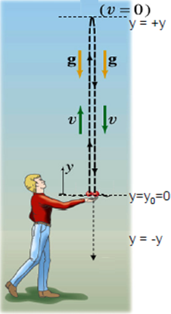
Determination of Sign Convention
Example: A ball which is thrown upwards from a boy’s hand and falls to the passed his hand to the ground. Fill up the sign convention for the below quantities. Let a.) upwards as positive, b.) downwards as positive
C
Point | Displacement, y | Velocity, v | Acceleration, g
A | 0 | + | -
B
C
D
E
F
B
D
A
E
F

Slide 11
Determination of displacement, velocity & acceleration graphically
If a displacement-time graph is given:
a.) the gradient of the graph represents the value of velocity
If a velocity-time graph is given:
a.) the gradient of the graph represents the value of acceleration
b.) the value of velocity represents the gradient of displacement-time graph
c.) the area under the graph represents total displacement
If an acceleration-time graph is given:
a.) the value of acceleration represents the gradient of velocity-time graph

Slide 12
Determination of displacement, velocity & acceleration graphically
Displacement-time
Gradient of displacement represents
thevalue..
Value of
velocity
Represents the
gradient..
Velocity-time
Gradient of
velocity represents the value..
Value of
acceleration
represents the
gradient..
Acceleration-time

Slide 13
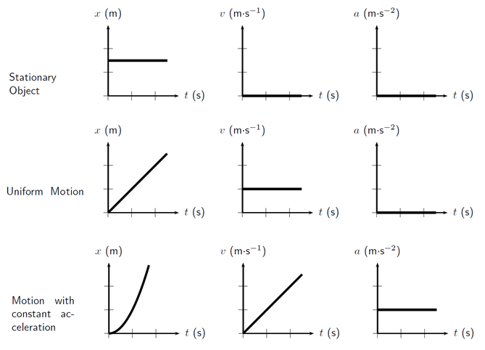
Determination of displacement, velocity & acceleration graphically
Relationship between displacement, velocity & acceleration as functions of time

Slide 14
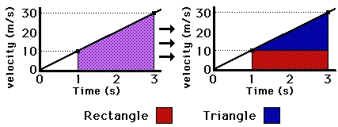
Area under Velocity-Time graph
The area under the velocity-time graph represents total displacement / distance
travelled for a given time interval.
Example: for the graph below find the total displacement for t=1s to t=3s
So total displacement / distance travelled is = 40 m

Slide 15
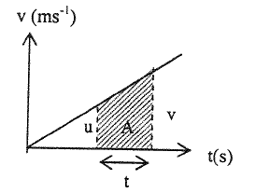
KINEMATICS EQUATIONS
The kinematics equations are very useful only for motion with constant acceleration.
If the acceleration is not constant (changes with time) then the below equation cannot be used.
Generally this is what each symbol means:
u = initial velocity, ms⁻¹ v = final velocity, ms⁻¹
s = displacement, m t = time taken, s
a = uniform acceleration, ms⁻²
1.) v = u + at
2.) s = ut + ½at²
3.) v² = u² + 2as
s = ½ (u + v) t
4.) s = ½ (u + v)t
a = (v - u) / t

Slide 16
Example 1
A car moves from the stationary state, undergoes uniform acceleration for 200 m in 5 s. After 5 s the car moves at a constant velocity for half a minute . The car then stops in 10 s. Find:
a) the acceleration of the car for the first 5 s
(ans: 16 ms⁻²)
b) the velocity of the car from the 5th s to the 10th s
(ans: 80 ms⁻¹)
c) the deceleration of the car
(ans: 8 ms⁻²)
d) the total displacement of the car
(ans: 3000 m )
e) sketch the acc-time graph
(ans: 16 ms⁻², 0, -8 ms⁻², 0)

Slide 17
Example 2
You are designing an airport for small planes. The airplane must reach a speed before takeoff of at least 27.8 ms⁻¹ , and can accelerate at 2.0 ms⁻².
a) If the runway is 150m long, can this airplane reach the proper speed to
takeoff ?
v = 24.5 m/s , which is lesser than 27.8 m/s.
Cannot. Runway length is not sufficient.
b) If not, what minimum length must the runway have ?
minimum length = 193 m

Slide 18
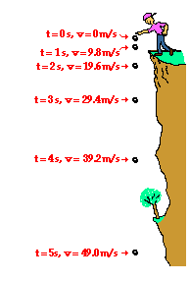
Acceleration due to GRAVITY / Free fall
A free falling object falls under the sole influence of gravity.
It does not encounter air resistance or air resistance is negligible.
Accelerates downwards at the rate of 9.81 ms⁻²
Symbol for acceleration of free-fall is g.
Acceleration of free fall is always acting downwards / towards the Earth.
If we take upwards direction as positive in our calculation of motion for a given scenario, then acceleration of free fall, g must be negative (since it is always acting downwards).

Slide 19
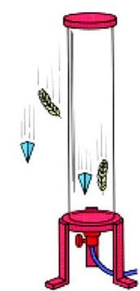
Effects of air resistance upon a falling object
In air
- a stone falls faster than a feather.
In vacuum
- the stone and the feather fall at the
same speed.
Gravity causes all objects to accelerate downwards at the same rate regardless of their mass.
But because of the presence of air resistance, lighter objects will fall slower compare to the heavier objects.

Slide 20
Example 3
A ball is thrown upwards from the ground with a velocity of 30 ms⁻¹.
Taking g = 9.81 ms⁻² and assuming that air resistance is negligible,
i) What is the maximum height reached?
Ans: 45.9 m
ii) After how many seconds will it strike the ground again?
Ans: 6.1 s
iii) What is the velocity just before it hits the ground?
Ans: 30 ms⁻¹

Slide 21
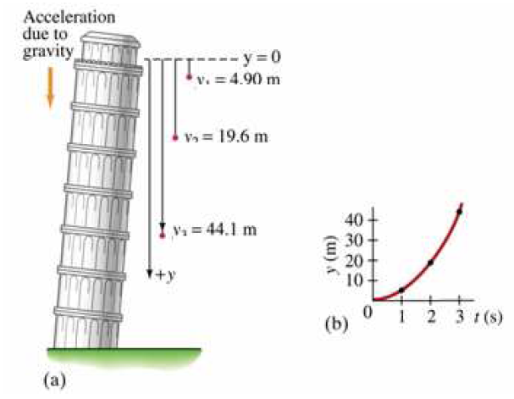
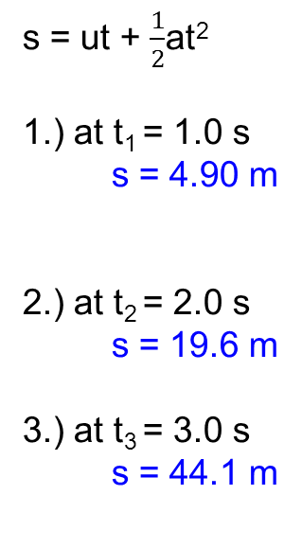
Example 4

Slide 22
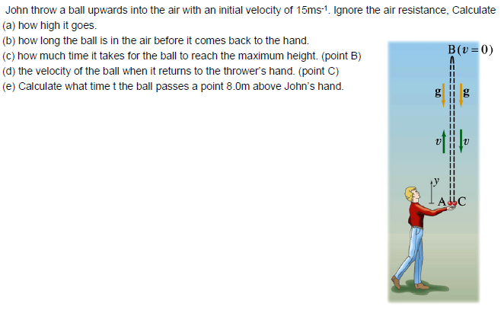
Example 5
a.) v² = u² + 2as
0² = 15² + 2(-9.81)s
s = 11.47 m
d.) v = u + at
v = 0 + (-9.81)(1.53)
v = -15 ms⁻¹
b.) s = ut + ½ at²
0 = (15)t + ½(-9.81) t²
t = 0 s and 3.06 s
e.) s = ut + ½ at²
8 = (15)t + ½(-9.81) t²
t = 0.69 s and 2.37 s
c.) v = u + at
0 = 15 + (-9.81)t
t = 1.53 s (time to reach top)

Slide 23
Terminal Speed
When an object falls, if the pull of gravity is opposed by air resistance, the object will not accelerate at value g. (9.81ms⁻²)
Air resistance increases with speed.
As the speed increases, so does the air resistance until the air resistance equals the pull of gravity.
Once equality is reached, no further acceleration is possible. Thus object continues to fall at constant speed, called its terminal speed.
The same general ideas apply when an object falls through water or any other fluid.
The object reaches terminal speed more quickly in water than in air because the water resistance is much greater than the air resistance.

Slide 24
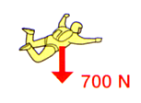
The parachutist has just jumped out of the aircraft, and is falling faster and faster ("accelerating").
As her speed increases, the air resistance also increases.

Slide 25
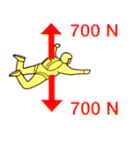
The parachutist is now falling fast enough for the air resistance to equal her weight.
This means that the forces on her are in balance, so her speed stops increasing and stays constant - she has reached her terminal velocity.

Slide 26
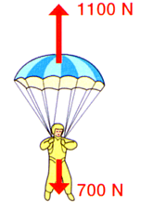
Time to open the parachute. This dramatically increases the air resistance, so the parachutist slows down greatly ("decelerates").
Acceleration is acting upwards for this instant, meanwhile velocity is still acting downwards, and its value reduces non linearly.
For a few seconds, the air resistance is greater than her weight. As she decelerates, the air resistance decreases.

Slide 27
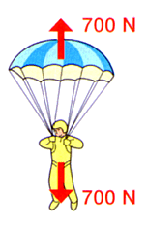
She's slowed down, and now the forces are back in balance.
Her speed is constant again - she has a new, much slower, terminal velocity.

Slide 28
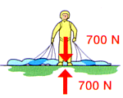
On the ground, her speed immediately drops to zero. Her weight downwards equals the ground's push upwards, so there she stays.

Slide 29
Projectile Motion
A projectile is an object moving in two dimensions:
Under the influence of earth's gravity, g for the vertical motion.
it’s path is a parabola.
which can be understood by analyzing the horizontal and vertical motions separately.
in the diagram on the right, both objects hit the ground at the same time.
the horizontal & vertical movements are independent of each other.
The horizontal motion will not affect the rate of fall of the ball.

Slide 30
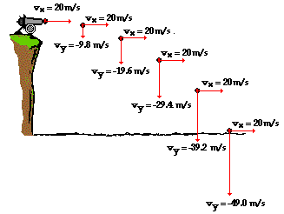
Horizontal & Vertical components of velocity
Time | Horizontal Velocity | Vertical Velocity
0 s | 20 ms⁻¹ | 0 ms⁻¹
1 s | 20 ms⁻¹ | 9.81 ms⁻¹
2 s | 20 ms⁻¹ | 19.62 ms⁻¹
3 s | 20 ms⁻¹ | 29.43 ms⁻¹
4 s | 20 ms⁻¹ | 39.24 ms⁻¹
5 s | 20 ms⁻¹ | 49.05 ms⁻¹
Projectiles travel with a parabolic trajectory.
No horizontal force or acceleration.
Horizontal velocity is constant.
Vertical acceleration is 9.81 ms⁻² due to gravity.
Vertical velocity changes 9.81 ms⁻¹ every second.

Slide 31
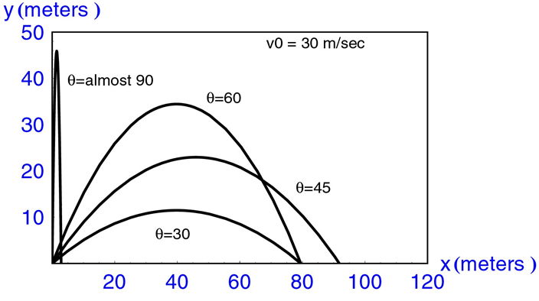
Factors affecting Projectile Motion
Two factors affect projectile motion:
a.) initial velocity of the projectile.
b.) angle of the projection.

Slide 32
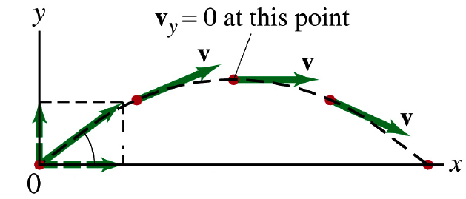
Analysis of Projectile Motion
Consider an object that is projected into the sky with an initial speed of u and at an angle of θ with the horizontal.
u
Max. height
u_{y} = u sinθ
θ
u_{x} = u cosθ
Range

Slide 33
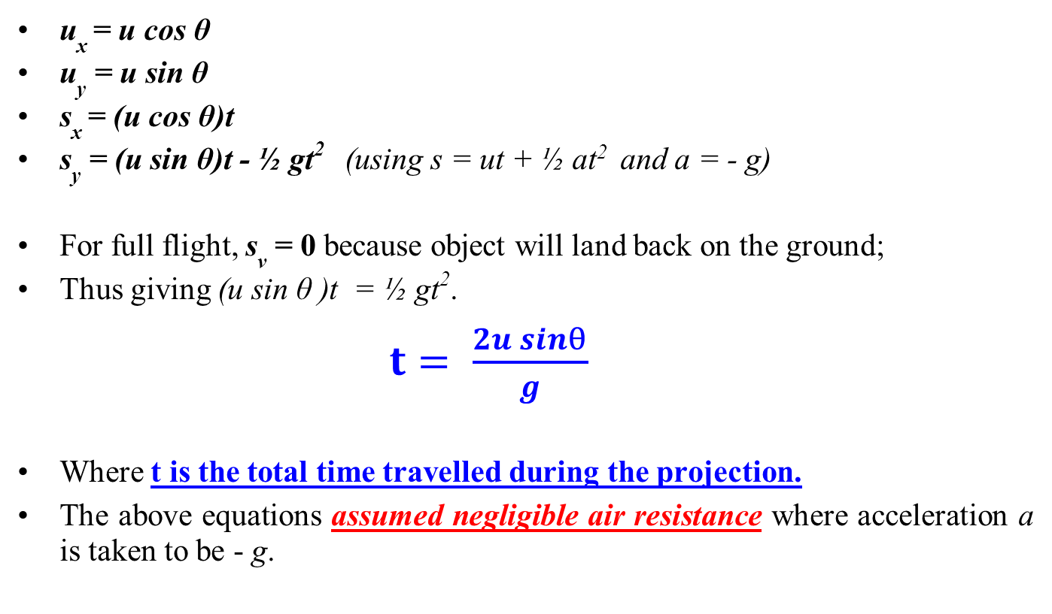
Analysis of Projectile Motion (Cont…)

Slide 34
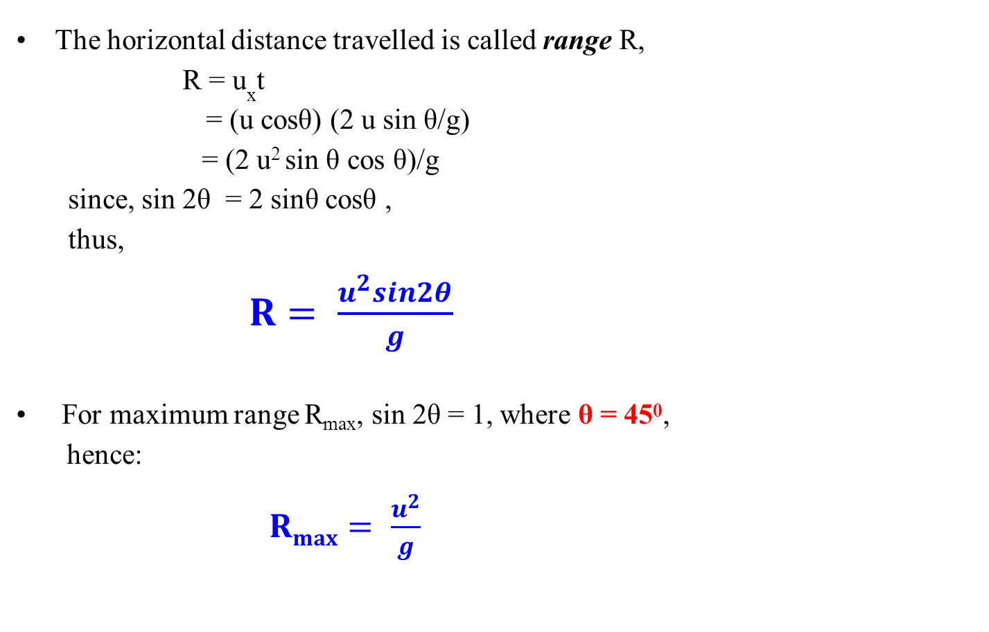
Analysis of Projectile Motion (Cont…)

Slide 35
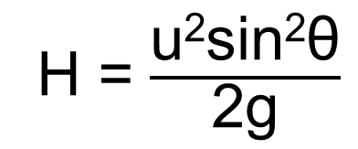
Analysis of Projectile Motion (Cont…)
To calculate maximum height (H), v_{y} = 0, thus:
v_{y}² = u_{y}² +2a_{y}s_{y}
0 = (usin θ) ² – 2gH

Slide 36
Example 6
A stone is thrown from the top of a vertical cliff, 45m high above level ground, with an initial velocity of 15m/s in horizontal direction.
a.) How long will it take to reach the ground?
b.) How far from the base of the cliff is it when it reaches the ground?
s_{y} = u_{y}t + ½ a_{y}t²
45 = 0 + ½ (9.81) t²
t = √ [ (45)(2) / (9.81) ]
t = 3.0 s
s_{x} = u_{x}t
s_{x} = (15 x 3.0) = 45 m

Slide 37
Example 7
A footballer kicks a ball which is initially at rest on a horizontal pitch. It acquires a velocity of 17 ms⁻¹ at an angle of 40º to the horizontal. Air resistance may be neglected.
Calculate
(a) the time of flight of the ball before it lands on the pitch again and
(b) the horizontal distance traveled by the ball during its flight.
(c) without further calculation, suggest how the same horizontal distance could have been achieved with the same initial speed but a longer time of flight.

Slide 38
Example 7
a)
s_{y} = (u sin θ)t + ½ at²
For full flight,
s_{y} = 0, a = - 9.81 ms⁻², (u sin θ) = 17 x sin 40⁰
t = 2 u sin θ/g = (2 x 17 x sin 40⁰)/9.81 = 2.2 s
b)
s_{x} = (u cos θ)t = 17 x cos 40⁰ x 2.2 = 29 m
c)
Increase angle of projection with the horizontal.
ANGLE = 50° [mathematically, sin 2(40°) = sin 2(50°)]

